Slide 1
COPADS
#6 – Networking Basics
IFEOLUWATAYO IGE

Slide 2
OUTLINE
Deadline for Project 1-Friday
In-class Activity this week
Mid Exam- Two weeks’ time
Computer Networks
Protocol layers
Addressing
TCP versus UDP
C# and Networking

Slide 3
Computer Networks and Protocols
A computer network consists of two or more computing devices connected in a transmission medium to exchange data.
Protocols are the standards used to communicate over the network. It defines the rules that govern the communications between two devices connected to the network.

Slide 4
Networks: Types based on size
LAN (Local Area Network) – a group of electronic devices connected in a small area
High speed due to their small size
Small area
Secure and reliable because it is private. Data shared is relatively safe.
No longer limited to a wired connection, could be wireless connections called wireless LAN.
Multiple devices are connected to a wireless router, which links them to the internet.
WAN (Wide Area Network)-
covers a very large area, country, continent, etc.
High capacity in terms of bandwidth
expensive in terms of installation cost, issue resolution takes time.

Slide 5
Network Protocols and Layering
A networking system is divided into layers based on standard architectures/models.
For each layer, network protocols are designed to achieve each layer’s functionality
TCP/IP Model (Transmission Control Protocol/Internet Protocol (TCP/IP)
Developed by the Department of Defense (DOD) in the 1960s.
ISO OSI Model – (International Organization for Standardization -(Open Systems Interconnection )
A conceptual/Theoretical model developed by Hubert Zimmermann in 1978
7 Layers

Slide 6
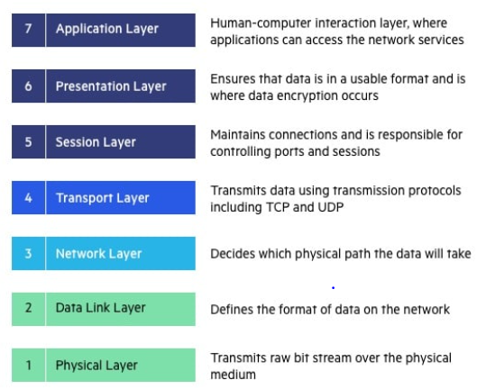
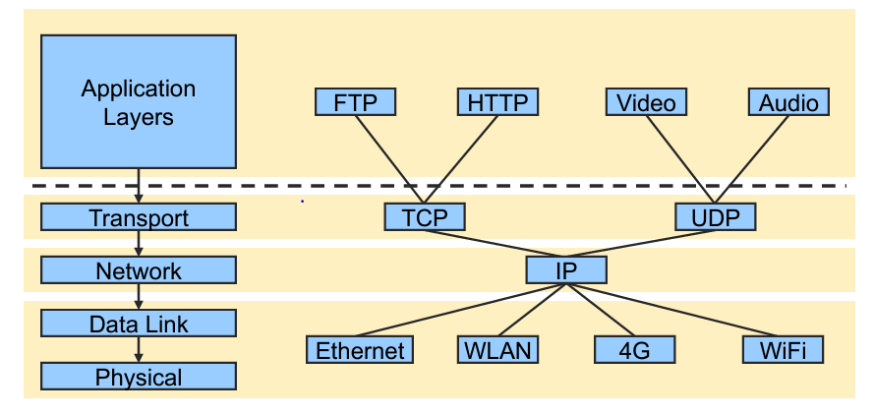
ISO/OSI MODEL
Protocols available at each layer
The OSI model is discussed extensively in CSCI 351

Slide 7
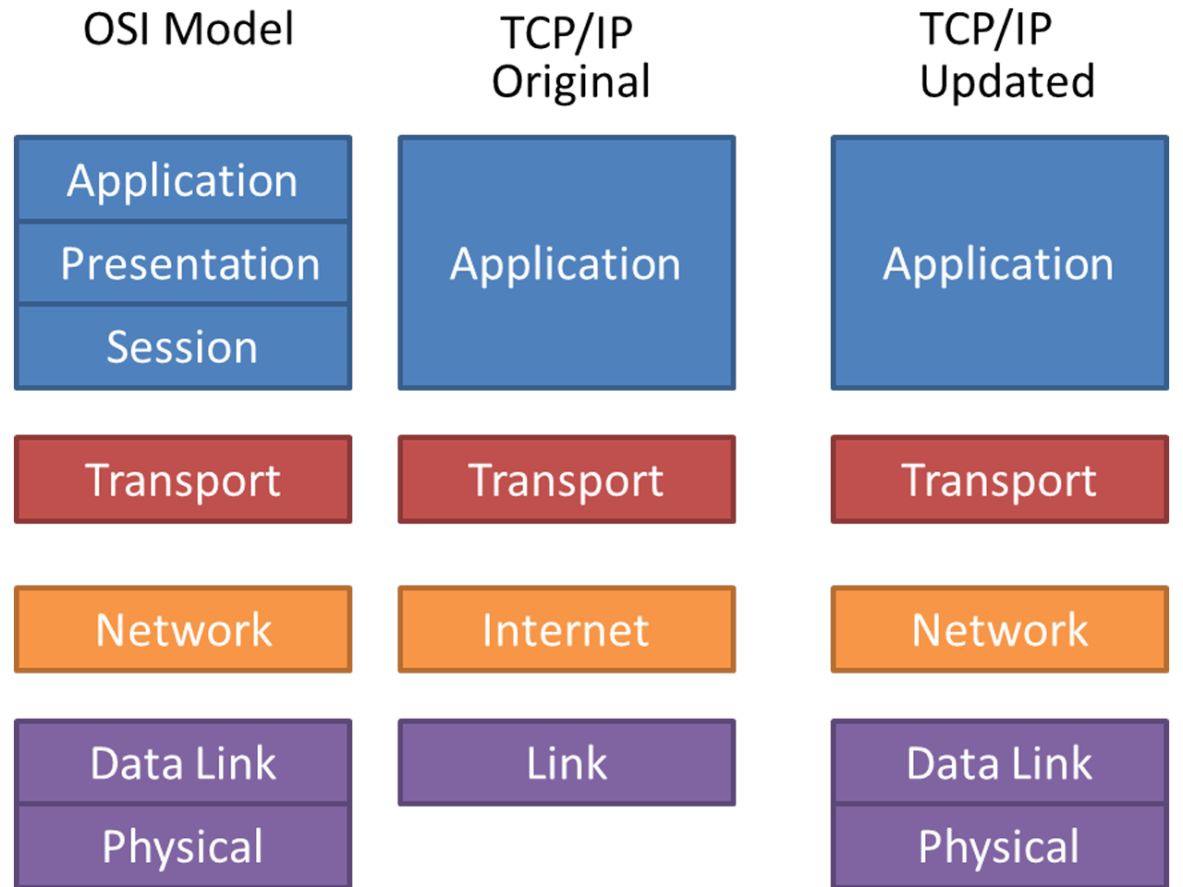

Slide 8
TCP/IP MODEL- Layers
Application Layer
Transport Layer
1. Application Layer: Interfaces applications running on the network
Protocols involved in this layer: HTTP, FTP, SMTP, etc.
2. Transport Layer
UDP (User Datagram Protocol):
The destination IP address and port number information is required when sending a UDP packet
Unreliable packet delivery- packets may not arrive at all due to unstable internet connection, cut cables, etc.
Not sure of a successful transmission as there is no way for a client to acknowledge a receipt of a UDP packet
No provisions for flow control: Packets may not be received in the order to which they were sent
A better protocol for speed and low overhead but still unreliable
Network/Internet Layer
Link Layer

Slide 9
TCP (Transmission Control Protocol):
It establishes a connection between the two endpoints via a socket which is always opened throughout the duration of the communication
Although the client socket is assigned a unique port number, the server port number is always the same.
A server can thus listen on one port, and communicate with multiple clients at the same time
Tracks packets via sequence numbers to be sure that they are delivered in the correct order with the use of streams
Acknowledgement bit packets are sent by recipients
Packet retransmissions are performed if packets are missed or arrive out of order
The IP address of the server, the IP address of the client, the Port number of the server, and the Port number of the client are all required when a TCP packet is sent. These are useful for acknowledgment and retransmission.

Slide 10
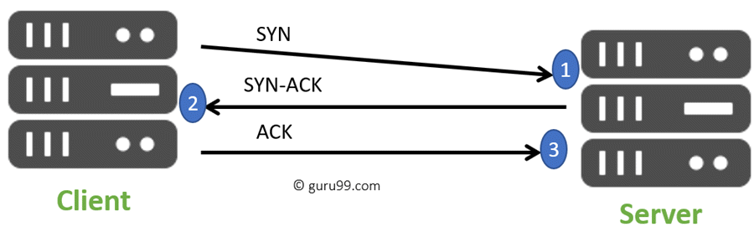
Transport Layer of TCP/IP Model - TCP/UDP
Characteristics | TCP (Transmission Control Protocol) | UDP (User Datagram Protocol)
Protocol Connection Setup | Connection oriented | Connectionless. Data is sent without setup
Reliability and Acknowledgements | Reliable delivery of message. All data is acknowledged | Unreliable delivery without acknowledgment
Retransmission | Delivery of data is managed, and lost data is retransmitted automatically | No retransmission if data is lost
Overhead | Higher overhead than UDP | Very Low
Transmission speed | slower than UDP | Very High
Data Interface | Stream based | Datagram based
Weight of data | TCP is heavy. It requires a three-way handshake. | UDP is lightweight. There is no tracking of connections, ordering of messages Used for video streaming as it lowers the load on servers
Notes:
The procedure takes place between two TCP/IP nodes to establish a connection. Known as the "SYN, SYN-ACK, ACK handshake," computer A transmits a SYNchronize packet to computer B, which sends back a SYNchronize-ACKnowledge packet to A

Slide 11
3. Network Layer
Responsible for point-to-point communication and logical transmission of data over the entire network via data routing
Three protocols in this layer :
IP (Internet Protocol) which delivers packets from the source host to the destination host by looking at the IP addresses in the packet headers. 2 versions: IPv4 and IPv6.
ICMP (Internet Control Message Protocol) which is responsible for providing hosts with information about network problems.
ARP(Address Resolution Protocol) which finds the hardware (MAC) address of a host from a known IP address.
4. Link Layer
How the data is encoded: Encapsulation of IP datagrams e.g. packets, in format understandable by the network.
More details about this layer will be discussed in CSCI 351

Slide 12
ADDRESSING
Every machine must have a unique address for unique identification of machines connected over a network- IP address
IP address is assigned by IANA (Internet Assigned Numbers Authority) to an organization
Domain Name System (DNS) is a naming database that maps Internet domain names into Internet Protocol (IP) addresses
- converts www.rit.edu to an IP address
IPv4 addresses are 32 bit numbers; IPv6 addresses are 128 bit numbers

Slide 13
Special Addresses (loopback)
The loopback address has been built into the IP domain system to allow for a device to send and receive its data packets
E.g. A data packet can be sent through a network and routed back to the same device where it originated.
The most used IP address on the loopback network is 127.0.0.1 for IPv4 and ::1 for IPv6.
The standard domain name for the address is localhost.
Allows for testing and thus no network traffic during testing

Slide 14
C# and Networking
We have the following .Net Core Namespaces among others:
System.Net
System.Net.Http
System.Net.Sockets
System.Net.NetworkInformation
Client - A client is the computer running a program that requests the service from a server.
Server – A server is simply a computer that provides solutions to clients’ requests.
Host (or node) – any machine
Transport Ports
Ports have assigned numbers that uniquely identify a connection endpoint and direct data to a specific service
Open cmd and type “netstat -a” to know the list of port connections
Reserved ports: Service Name and Transport Protocol Port Number Registry (iana.org)

Slide 15
Our first program
See sample 06-01
Using native sockets
We need to specify how we are connecting
Connect to a host and a port
Read the information into a buffer and output it to the screen
Run it by connecting to “time.nist.gov” to get the current time
With few exceptions, you will never want to use Sockets like this, the program terminates after the output.

Slide 16
TCPClient Class
We could use TCPClient (a class in System.Net.Sockets)
It provides simple methods for connecting stream data over a networks
See Sample 06-02
C# has a TCPClient class
The client program does not need to end after receiving data from the server.
With the use of async methods, we can create a new instance of the TCPClient which can wait asynchronously while executing some other lines of code such as sleeping, reading data from the keyboard, etc.

Slide 17
TCPListener() Class
It is a class in System.Net.Sockets.
It creates a socket that listens asynchronously for connections from TCP network clients while executing other statements.
See sample 06-03
Start the server (prints out the time), then telnet to localhost port 1313 to handle the connection (open cmd, type ‘telnet 127.0.0.1 1313’)
Teletype Network-(telnet) – A TCP/IP Protocol that allows you to log into a remote host.
How to Telnet (windows)
Control Panel\Programs\Programs and Features.
Click on Turn Windows features on or off on the left side panel and check the Telnet Client button
MAC machines: https://www.layerstack.com/resources/tutorials/Installing-Telnet-Client-on-macOS
The TcpListener class provides simple methods for creating a listening socket to accept incoming TCP connections and the TcpClient provides methods for connecting and communicating on a TCP connection.

Slide 18
Exceptions
We should handle exceptions in both the client and server (try…catch)
Network connections are unpredictable. Circumstances such as unplugging the cable or Turning off the wifi
Errors should be handled gracefully.
Also see that some conversions must be made before it can be written to the console (read and write byte arrays)
Lines 41, 41 (server)
Lines 29,30 (client)
Run 06-06 and see how it handles exceptions(06-05 (server), 06-06 (client))

Slide 19
Why Byte Arrays? StreamWriter/Reader Method
It would be nice if we didn’t need to read and write byte arrays
We want to deal with strings!
StreamWriter and StreamReader method
See Sample 06-07 (Server)
See Sample 06-08 (Client)

Slide 20
UDPClient
Used to represent a datagram
See sample 06-09 (server)
See sample 06-10 (client)
Notice that both sides create a UDP client.
One side binds to a known port.
The other side sends data to that known port
The UDP server is always listening. A UDP client only listens after sending a message, for a response.
The client does not form a connection with the server like in TCP but instead sends a datagram.

